Slide 1
Census Data Analyses
For White and Black Persons

Slide 2
Overview
Intro to Census Survey
Data Set and Objective
Hypotheses Testing Process
Hypotheses and Results
Findings Summary
Recommendations
Limitations and Further Steps

Slide 3

Census Data
Data
2020 Annual Social and Economic (ASEC) Supplement
Monthly labor force data and supplemental data on work experience, income, etc.
Use
Help determine funding allocation by federal governments for state governments and local communities
Health
Education
Housing
etc.
Sources: New York Times; Population Reference Bureau

Slide 4
Data Set and Objective
Dataset
Original: 158k rows, 840 columns
Modified: 12 columns, 122k rows for race White and Black
Two columns with continuous variables, rest categorical variables
Objective
Look at differences between White and Black persons
Help the federal governments allocate funds to address issues in black communities
Source: Datasets and Technical Documentation

Slide 5
Hypotheses Testing Process
Categorical Variables
Chi-Square Test
Cramer’s V
Continuous Variable
Remove outliers
Descriptive Statistic
Levene’s test for equal variance
Adequate statistical test (here: Welch’s t-test)
Tools:
Google Colab
Python
Python Libraries: pandas, numpy, scipy, plotly, matplotlib, seaborn, io, zipfile, urllib.request

Slide 6
Categorical Variables
Chi-Square and Cramer’s V

Slide 7
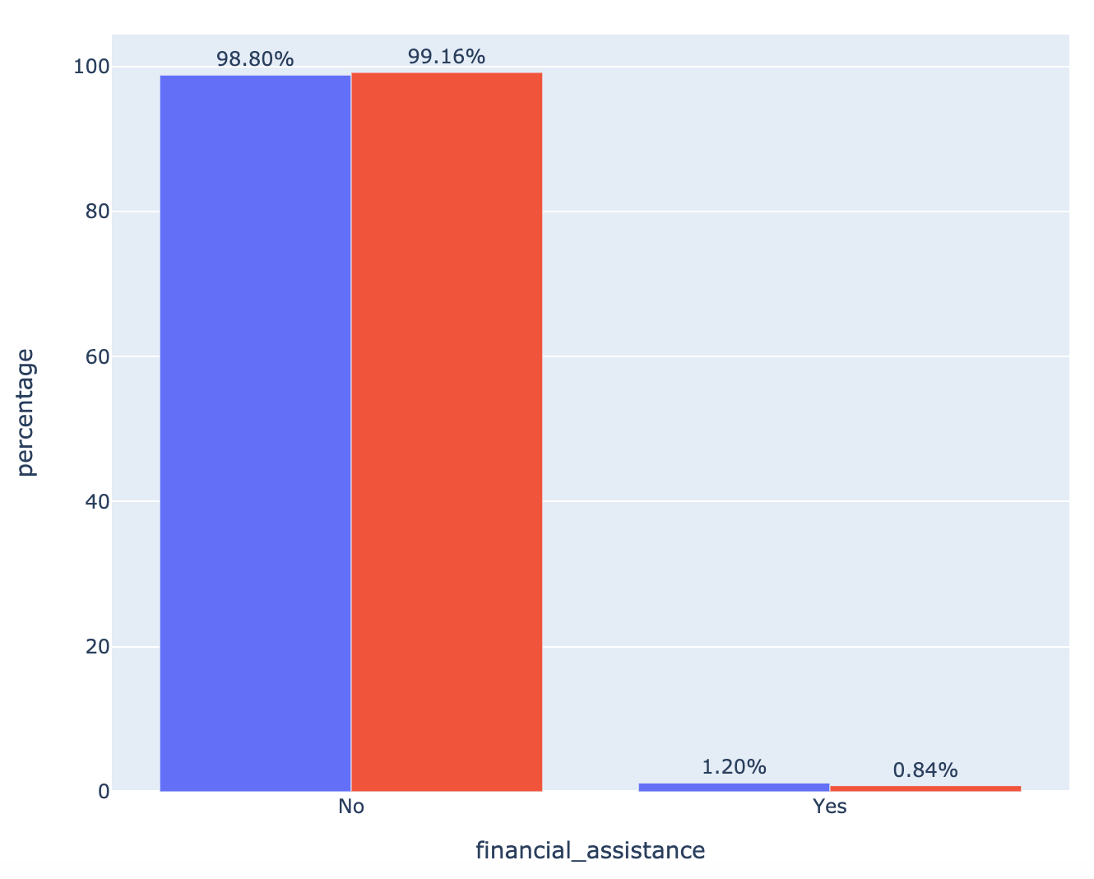

Race | Financial Assistance
Chi-Square Hypothesis
H₁: There is an effect of race on receiving financial assistance.
Result
Reject the Null that there is no effect of race on receiving financial assistance.
Cramer’s V
White 0.013963
Black 0.035730
Result
Significant chi-square could be due to large sample size.

Slide 8
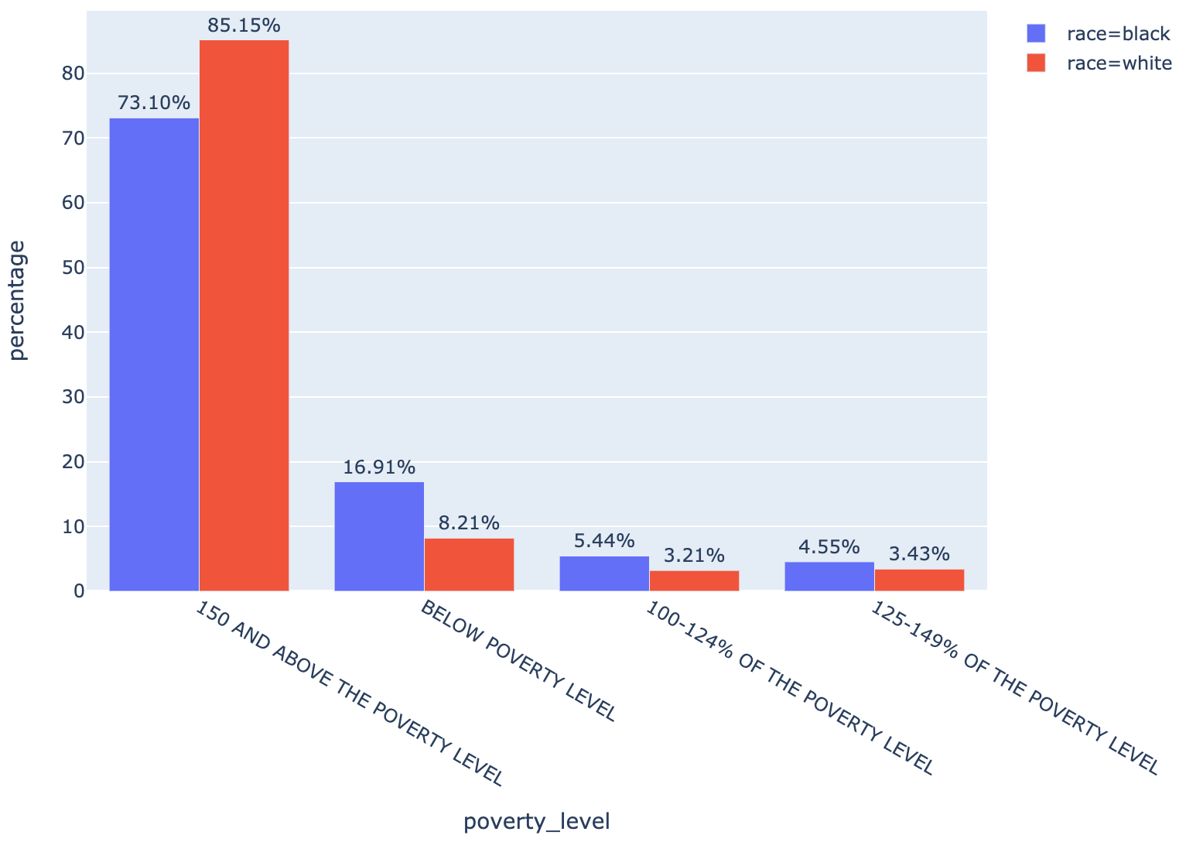
Race | Poverty Level
Chi-Square Hypothesis
H₁: There is an effect of race on poverty level.
Result
Reject the Null that there is no effect of race on poverty level.
Cramer’s V
White 0.123876
Black 0.316997
Result
White: low association Black: moderate association

Slide 9
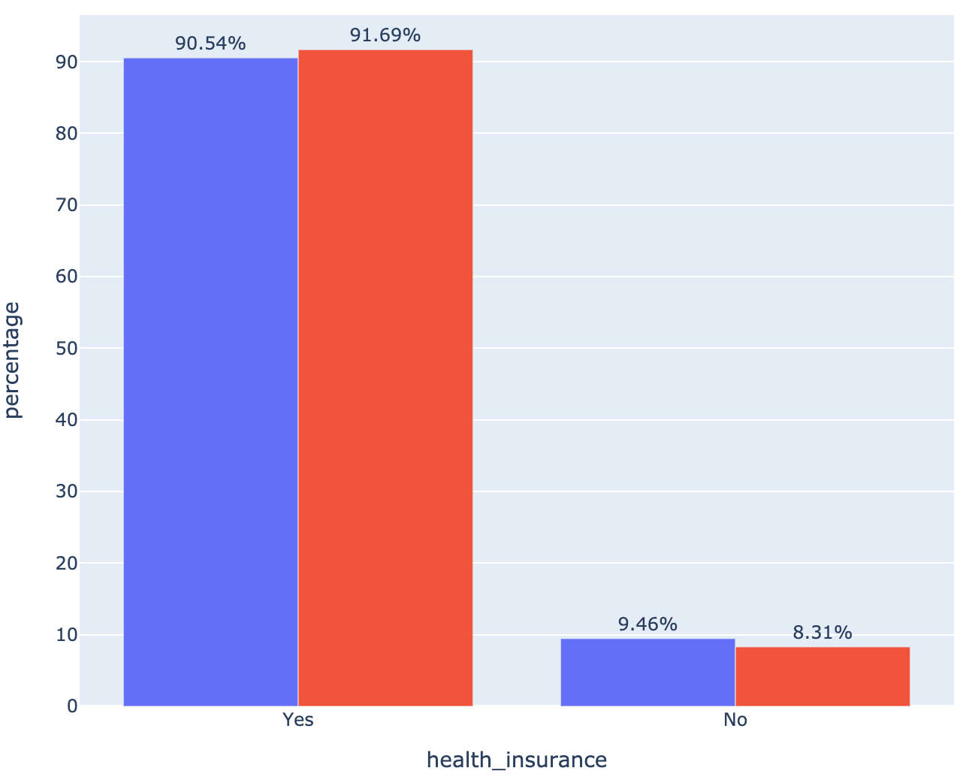
Race | Health Insurance Coverage
Chi-Square Hypothesis
H₁: There is an effect of race on receiving health insurance coverage.
Result
Reject the Null that there is no effect of race on receiving health insurance coverage.
Cramer’s V
White 0.015060
Black 0.038538
Result
Significant chi-square could be due to large sample size.

Slide 10
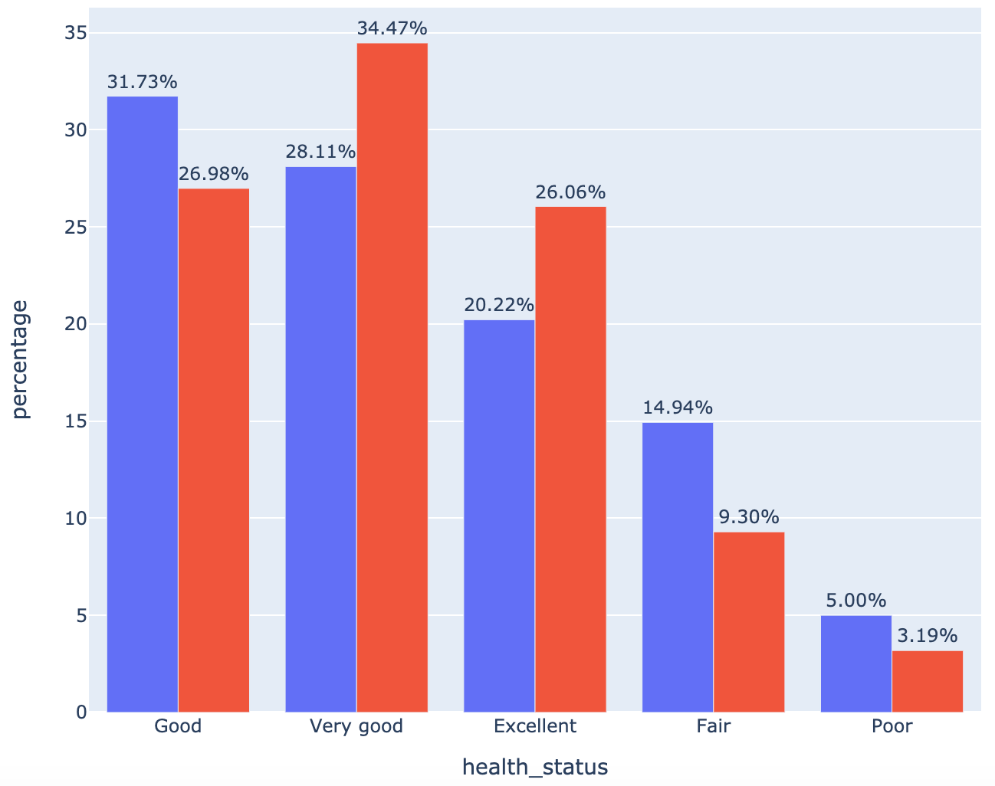
Race | Health Status
Chi-Square Hypothesis
H₁: There is an effect of race on health status.
Result
Reject the Null that there is no effect of race on health status.
Cramer’s V
White 0.099617
Black 0.254918
Result
White: little or no association Black: low association

Slide 11
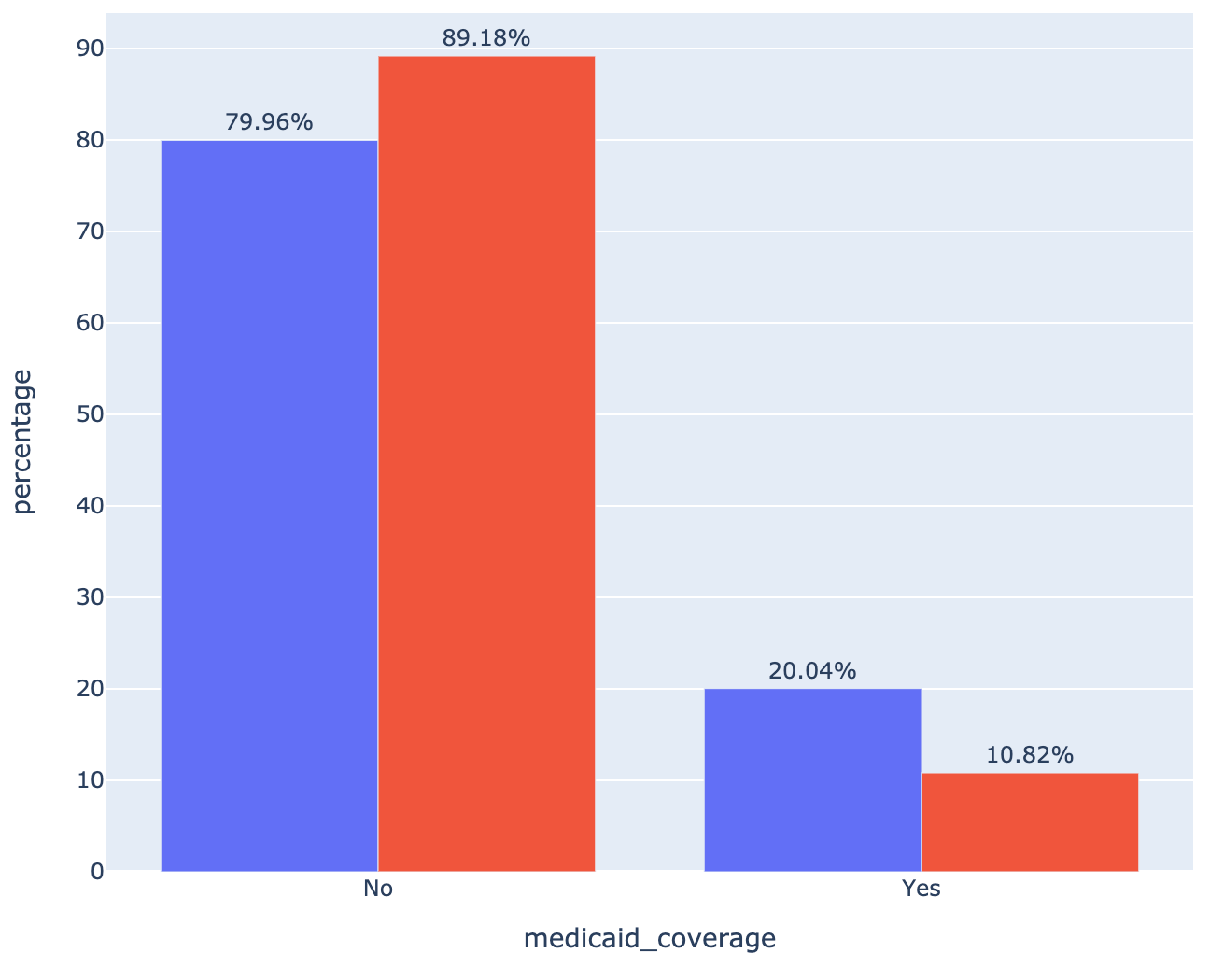
Race | Medicaid
Chi-Square Hypothesis
H₁: There is an effect of race on receiving Medicaid.
Result
Reject the Null that there is no effect of race on receiving Medicaid.
Cramer’s V
White 0.103079
Black 0.263776
Result
White: low association
Black: low association

Slide 12
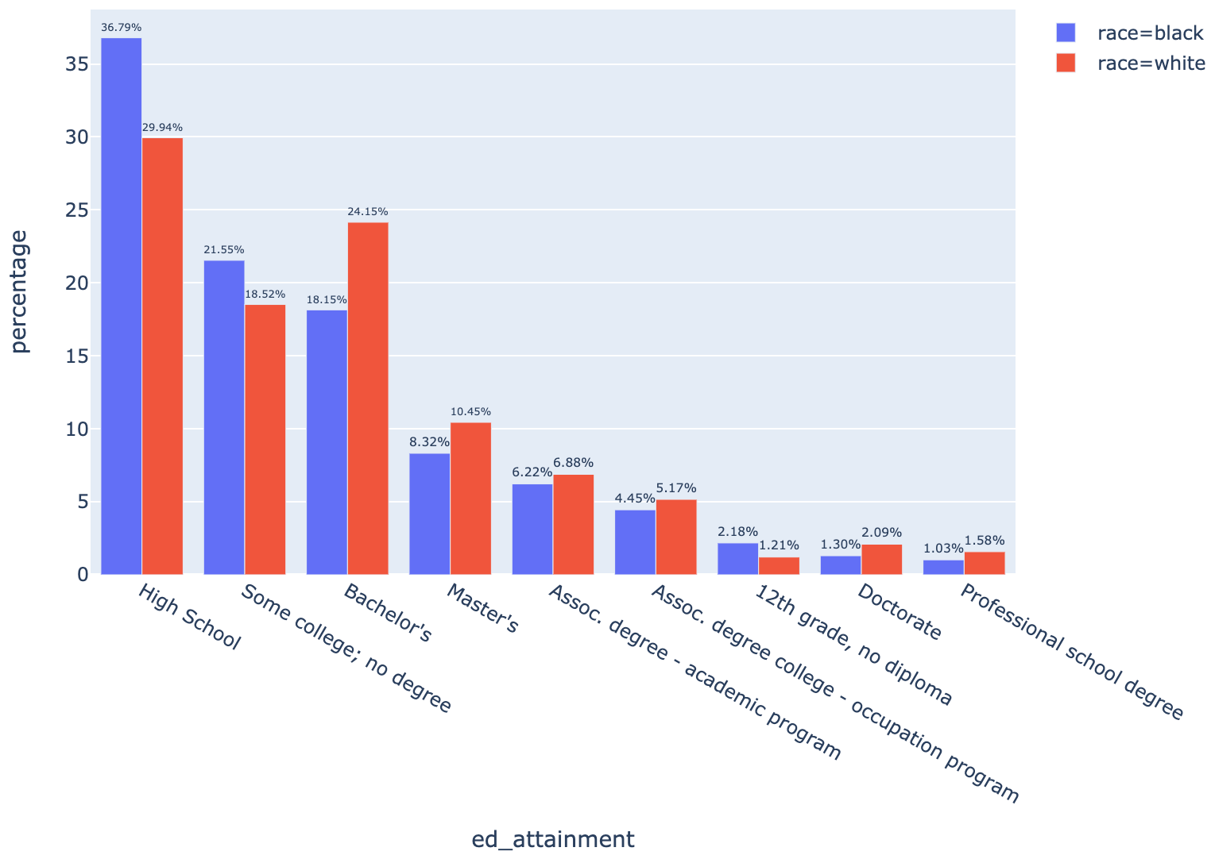
Race | Educational Attainment
Chi-Square Hypothesis
H₁: There is an effect of race on educational attainment.
Result
Reject the Null that there is no effect of race on educational attainment.
Cramer’s V
White 0.083786
Black 0.216166
Result
White: little or no association
Black: low association

Slide 13
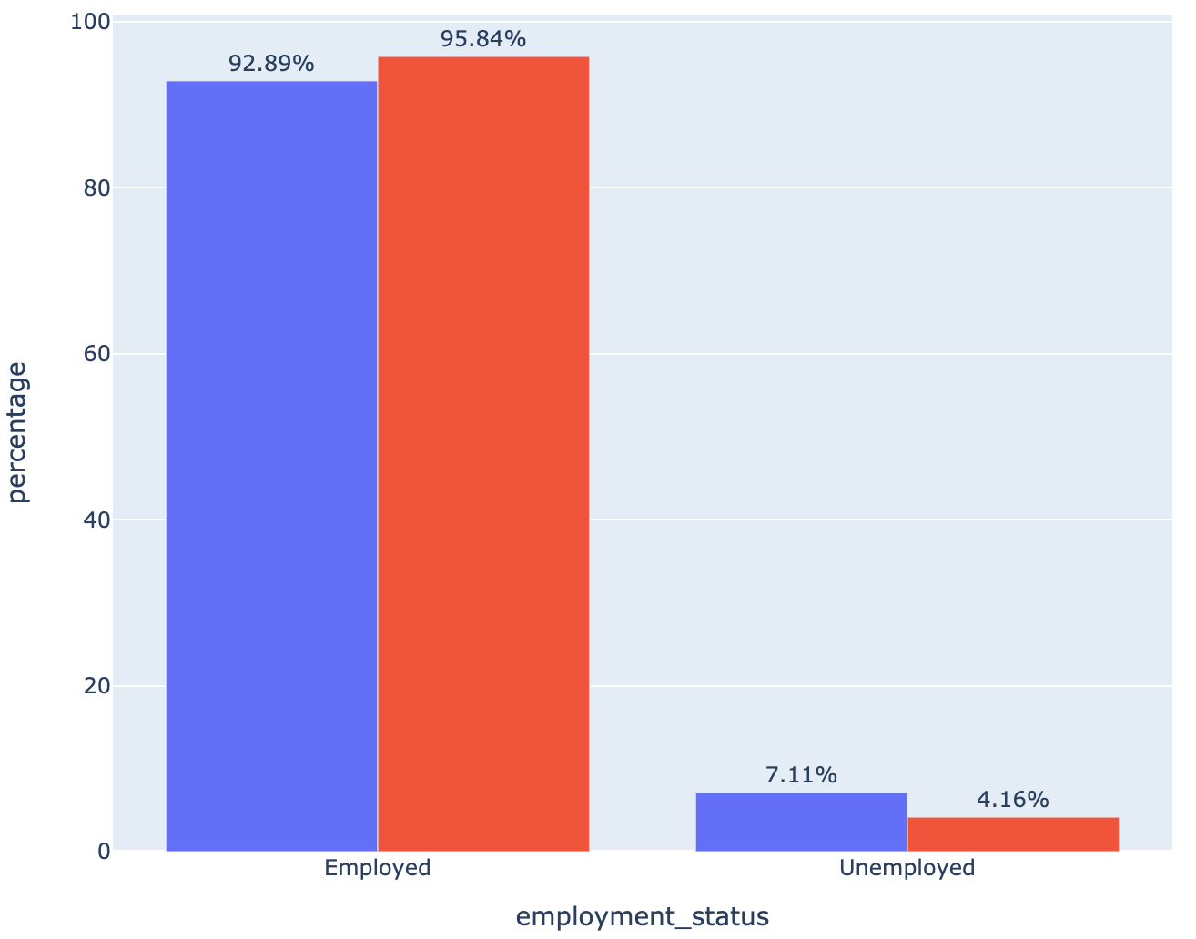
Race | Employment Status
Chi-Square Hypothesis
H₁: There is an effect of race on employment status.
Result
Reject the Null that there is no effect of race on employment status.
Cramer’s V
White 0.049333
Black 0.132705
Result
White: little or no association
Black: low association

Slide 14
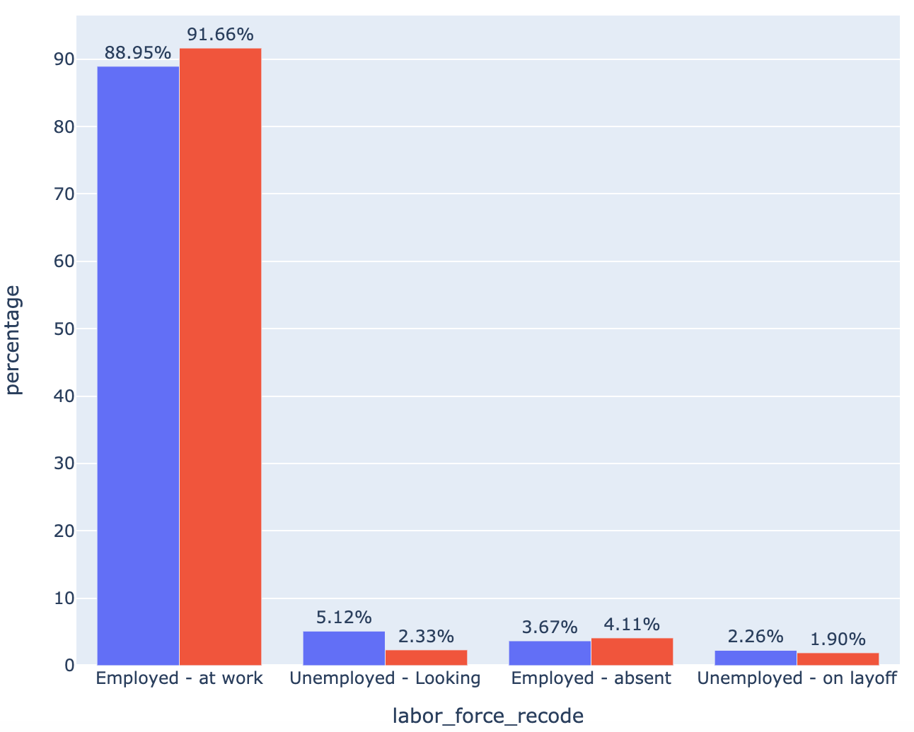
Race | Employment Status Extended
Chi-Square Hypothesis
H₁: There is an effect of race on employment status extended.
Result
Reject the Null that there is no effect of race on employment status extended.
Cramer’s V
White 0.061407
Black 0.165008
Result
White: little or no association
Black: low association

Slide 15
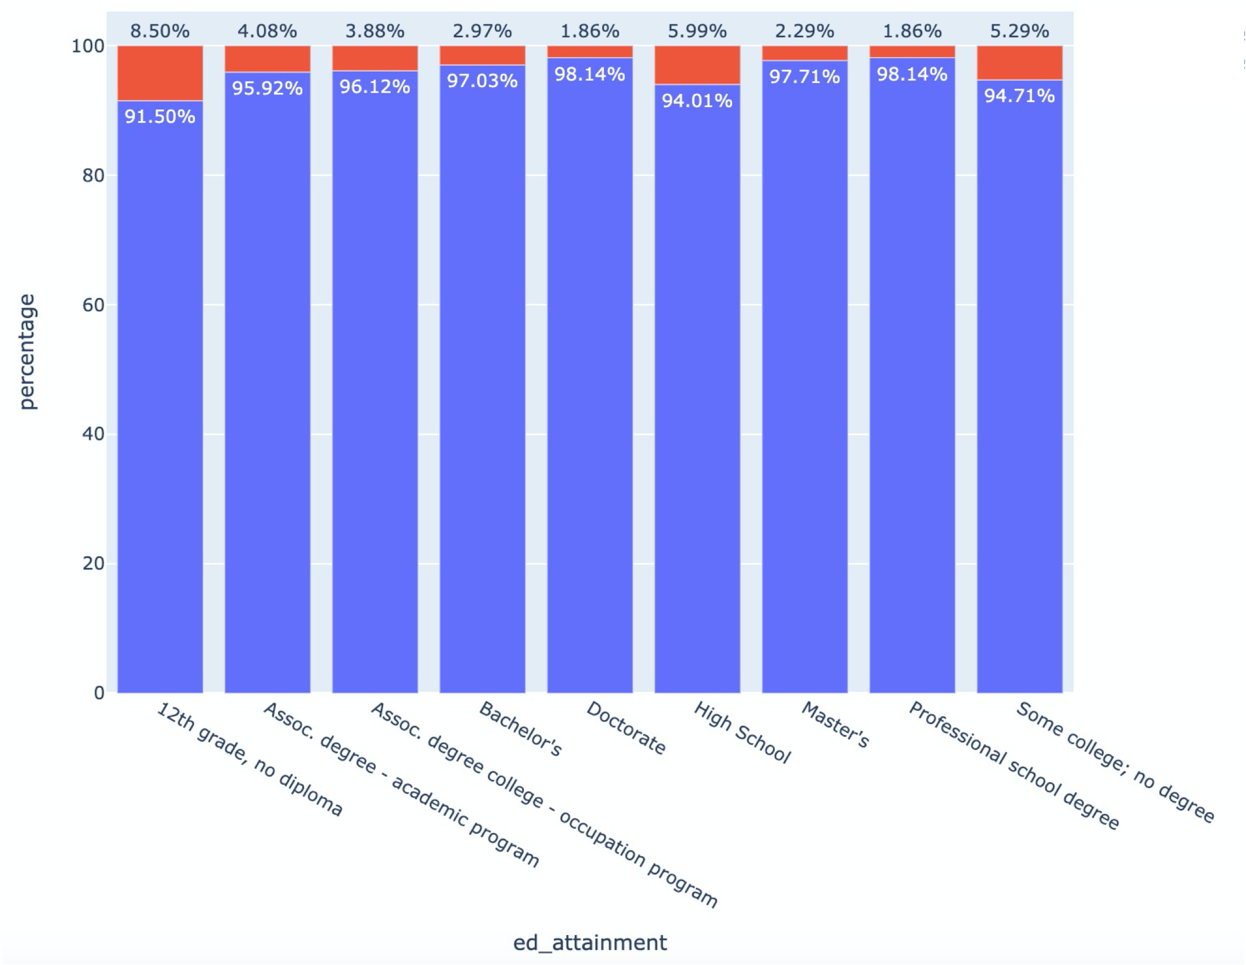

Education | Employment Status
Chi-Square Hypothesis
H₁: There is an effect of education on employment status.
Result
Reject the Null that there is no effect of education on employment status.
Cramer’s V
The results do not suggest that chi-square is statistically significant due to the large sample size.

Slide 16
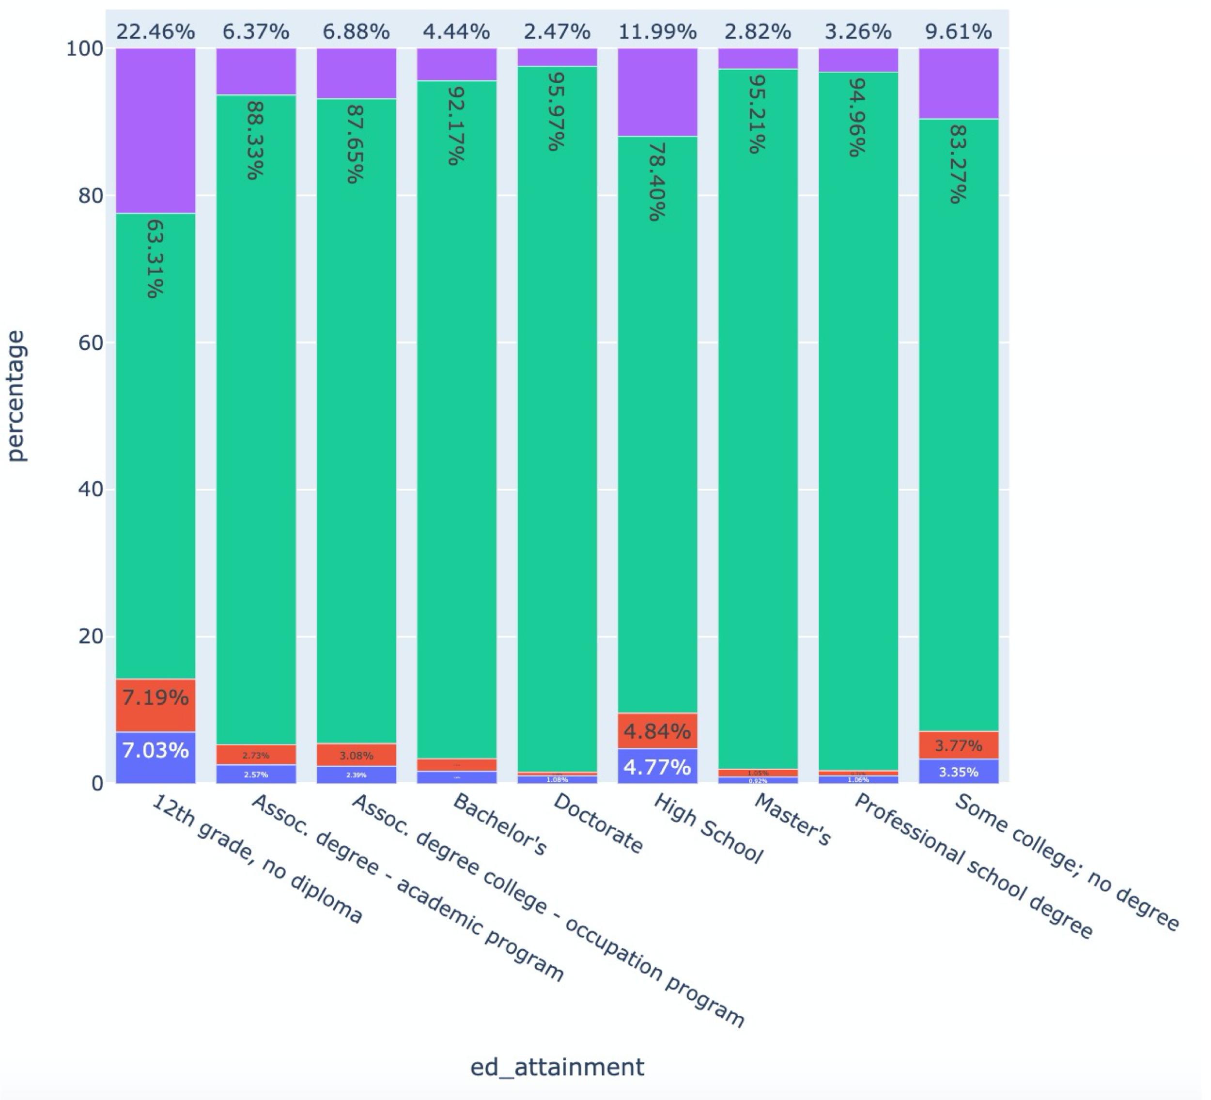
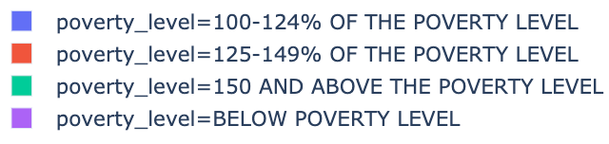
Education | Poverty Level
Chi-Square Hypothesis
H₁: There is an effect of education on poverty level.
Result
Reject the Null that there is no effect of education on poverty level.
Cramer’s V
The results do not suggest that chi-square is statistically significant due to the large sample size.

Slide 17
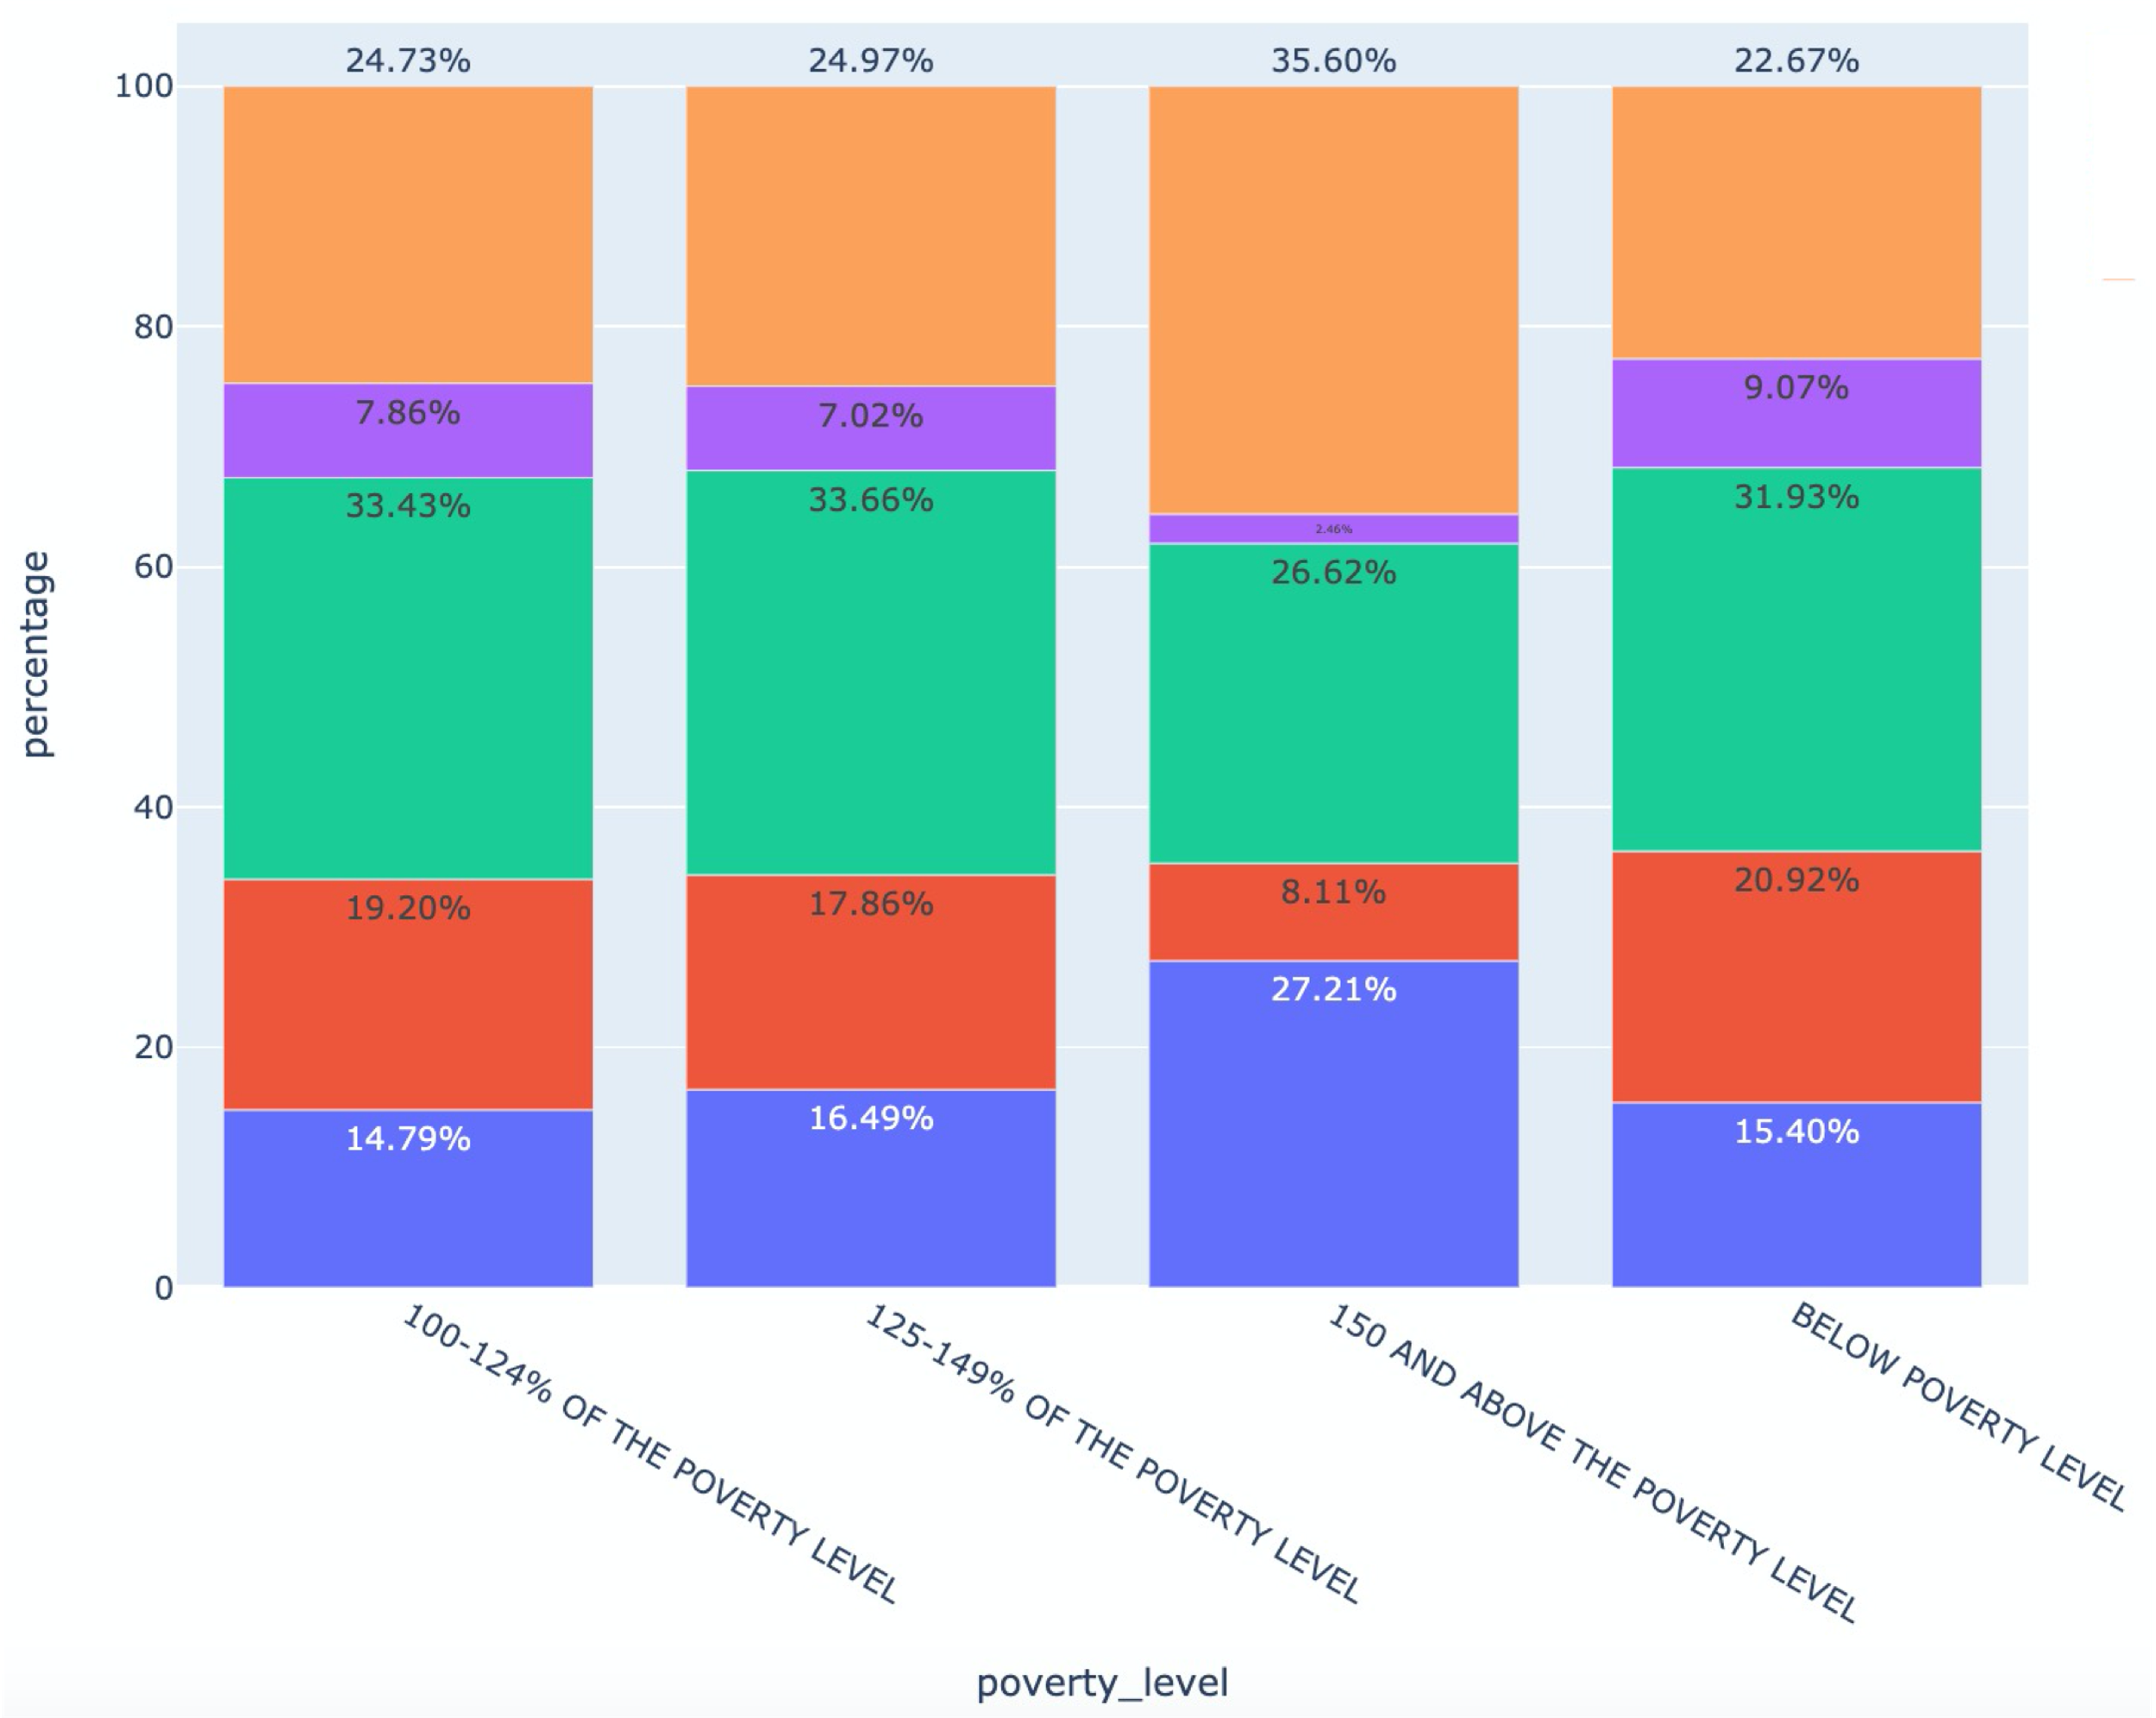
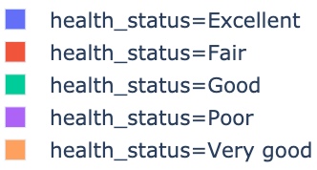
Poverty Level | Health Status
Chi-Square Hypothesis
H₁: There is an effect of poverty level on health status.
Result
Reject the Null that there is no effect of poverty level on health status.
Cramer’s V
The results do not suggest that chi-square is statistically significant due to the large sample size.

Slide 18
Continuous Variable
Remove outliers
Descriptive Statistic
Levene’s test
Welch’s t-test

Slide 19
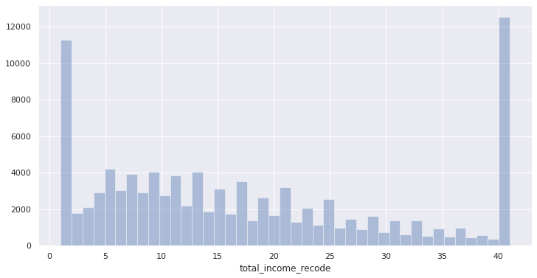
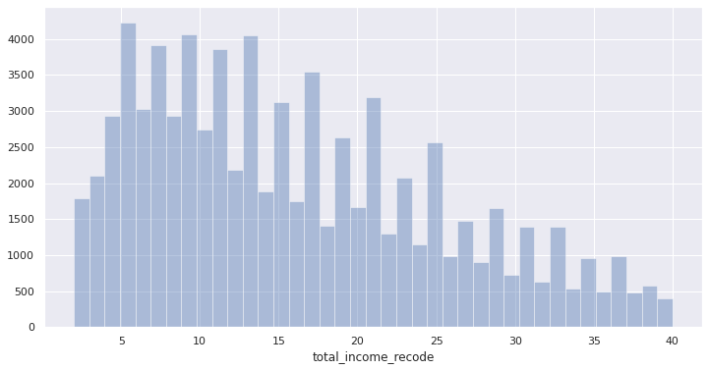
Race | Income Recode
1. Remove Income outliers
2. Descriptive Statistic
Acceptable kurtosis and skewness
3. Samples
Race: White and Black
5. Levene’s Test
H₀: The population variances are equal.
Result: Reject the Null that the population variances are equal.

Slide 20
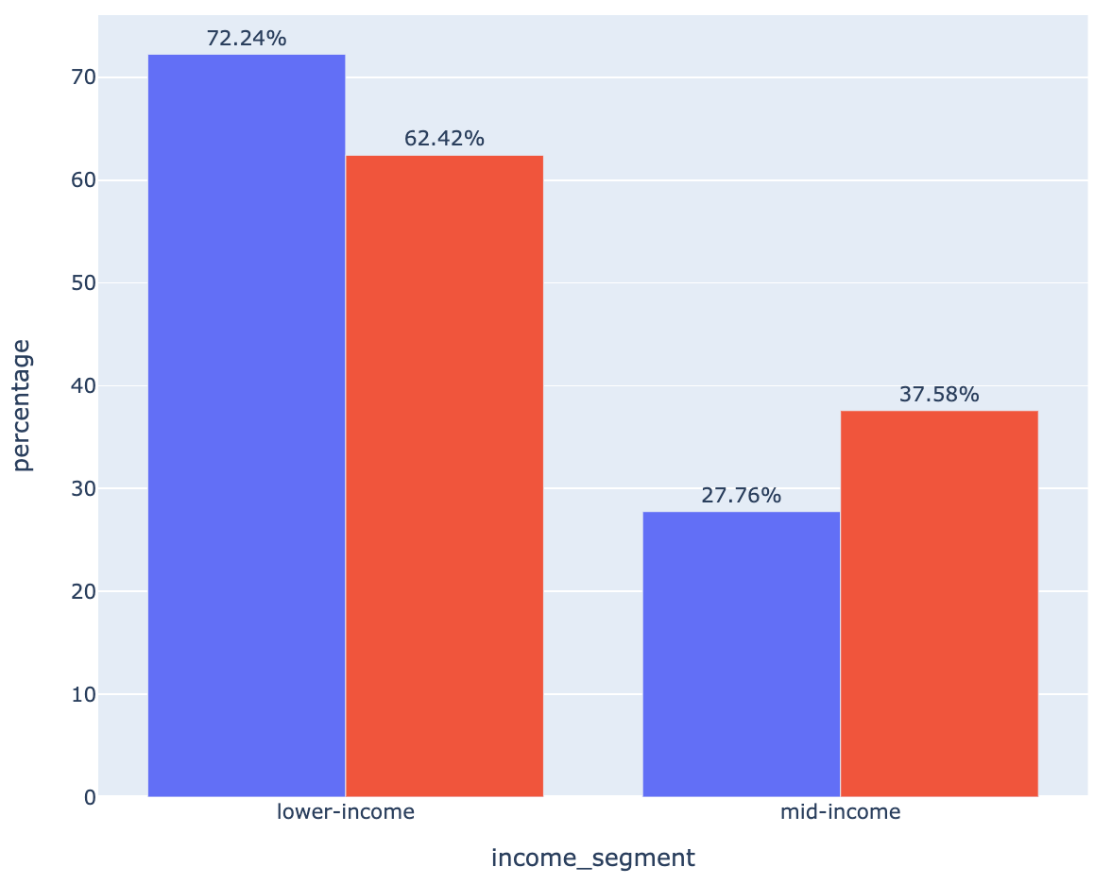
Race | Income Recode
Welch’s t-test
White income recode mean: 16.198371
Black income recode mean: 13.937720
H₁: The income mean of White is not equal to the mean of Black.
Result
Reject the null that there is no difference between the income means at p=0.0000.
This result suggests that the mean income of White is greater than the mean income of Black.

Slide 21
Summary of Findings
Black people are more likely to:
be below the poverty level
have poor health
receive Medicaid
have lower educational attainment
be unemployed
have a lower income
In general:
Those with lower education are more likely to be unemployed and close to the poverty level
Those closer to the poverty level also have poorer health

Slide 22
Recommendations
More funding towards programs that promote the education of Black communities starting in school.
Black persons are more likely to have no High School Diploma or only a High School Diploma
Funding to organizations that help fight poverty and improve the health of Black communities
Example: U.S. Department of Health and Human Services Office of Minority Health

Slide 23
Limitations and Further Steps
Modified dataset
White: 88,082 rows
Black: 13,451 rows
Difference in sample sizes leads to issues with statistical tests
Cramér's V for White → significant chi-square due to large sample size
Solution:
Reduce sample size for White (and Black) and rerun tests

